Slide 1
Java Programming
Write once, run anywhere

Slide 2
Content of the Day
Module3 : Advanced java | 0- Recap of Java Basics 1- Recap on Object-Oriented Programming (OOP) Concepts 2- Strings 3- Exceptions 4- Generics

Slide 3
3.1
Strings in java
Empowering Textual Manipulation and Beyond

Slide 4
Strings
Strings in Memory
String objects are immutable
String Compare
String Concatenation
String Methods
String Buffer

Slide 5
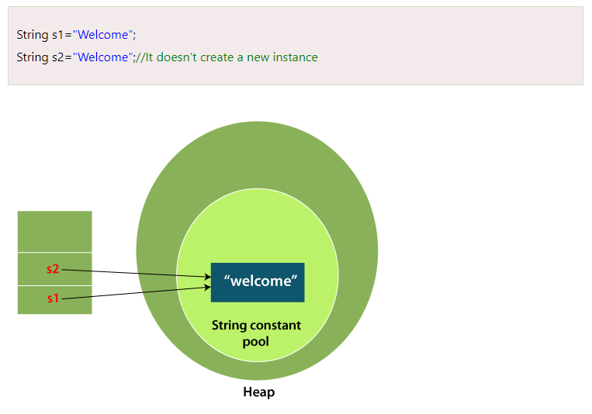
String in Memory
Notes:
Each time you create a string literal, the JVM checks the "string constant pool" first. If the string already exists in the pool, a reference to the pooled instance is returned. If the string doesn't exist in the pool, a new string instance is created and placed in the pool.

Slide 6
Why Java uses the concept of String literal?
To make Java more memory efficient (because no new objects are created if it exists already in the string constant pool).
String s=new String("Welcome");
//creates two objects and one reference variable
In such case, JVM will create a new string object in normal (non-pool) heap memory, and the literal "Welcome" will be placed in the string constant pool. The variable s will refer to the object in a heap (non-pool).

Slide 7
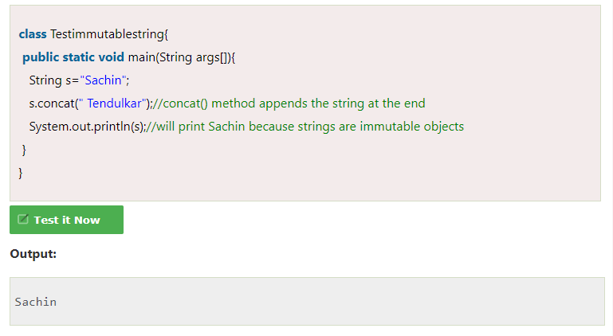
Immutable String in Java
Notes:
String objects are immutable. Immutable simply means unmodifiable or unchangeable.
Once String object is created its data or state can't be changed but a new String object is created.

Slide 8
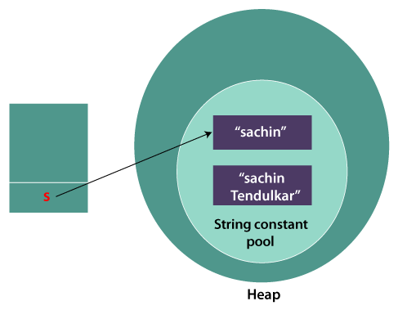
Immutable String in Java
Notes:
String objects are immutable. Immutable simply means unmodifiable or unchangeable.
Once String object is created its data or state can't be changed but a new String object is created.
As you can see in the above figure that two objects are created but s reference variable still refers to "Sachin" not to "Sachin Tendulkar".

Slide 9
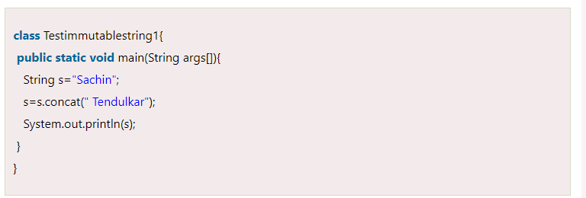
Immutable String in Java
Notes:
String objects are immutable. Immutable simply means unmodifiable or unchangeable.

Slide 10
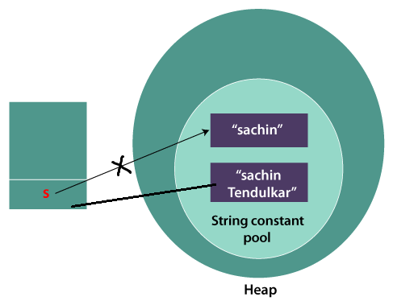
Immutable String in Java

Slide 11

Java String compare
Notes:
We can compare String in Java on the basis of content and reference.

Slide 12
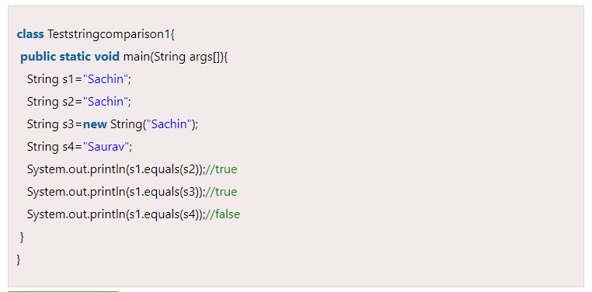
1) By Using equals() Method
Notes:
In such a case, s points to the "Sachin Tendulkar". Please notice that still Sachin object is not modified.

Slide 13
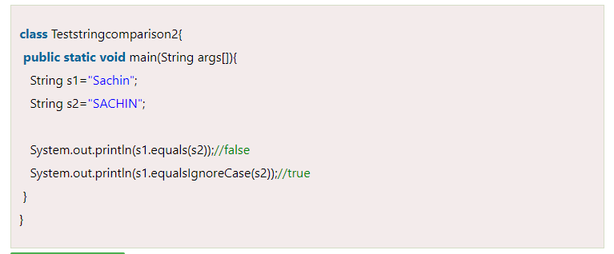
2) By Using equalsIgnoreCase() Method
Notes:
It compares values of string for equality.

Slide 14
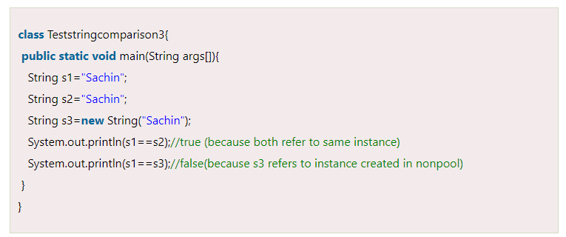
3) By Using == operator
Notes:
The == operator compares references not values.

Slide 15
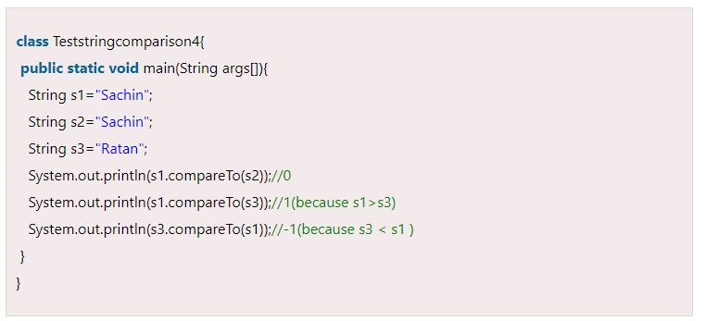
4) String compare by compareTo() method
Notes:
The String class compareTo() method compares values lexicographically and returns an integer value that describes if first string is less than, equal to or greater than second string.

Slide 16
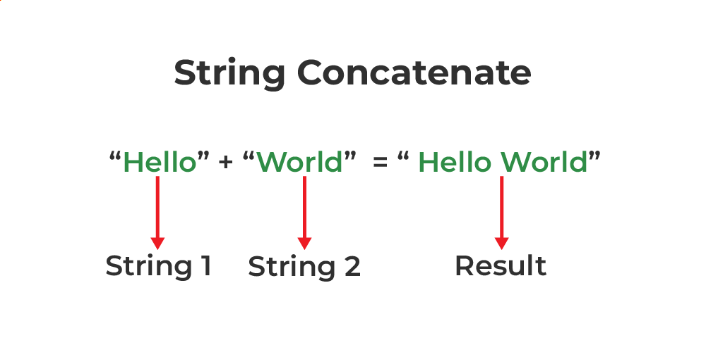
String Concatenation
Notes:
Java String concatenation operator (+) is used to add strings.

Slide 17
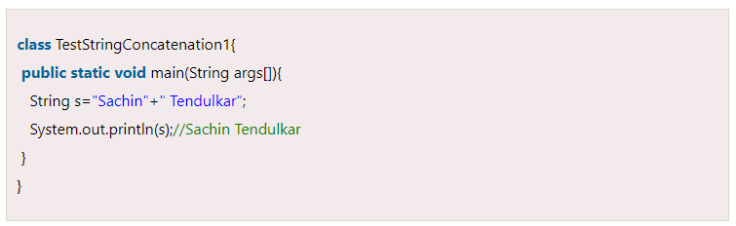
1 ) String Concatenation by + operator
Notes:
Java String concatenation operator (+) is used to add strings.

Slide 18
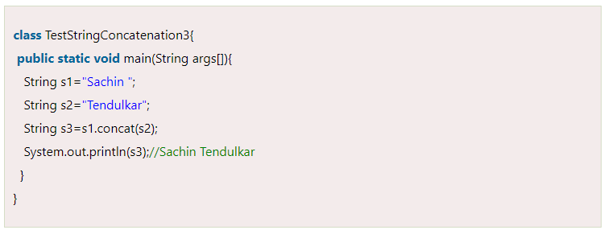
2) String Concatenation by concat() method
Notes:
The String concat() method concatenates the specified string to the end of current string.

Slide 19
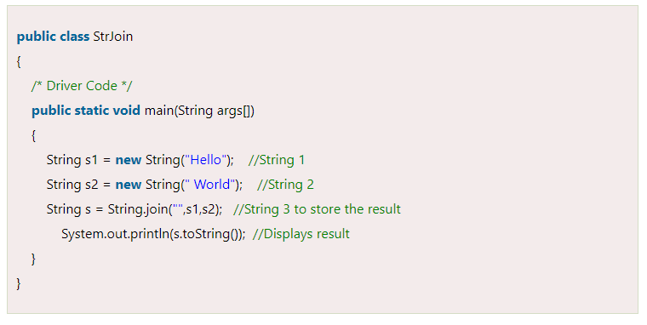
3. String concatenation using String.join()
Notes:
The String.join() method is available in Java version 8 and all the above versions. String.join() method accepts arguments first a separator and an array of String objects.

Slide 20
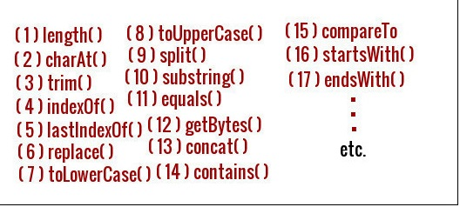
String Methods
Notes:
startIndex: inclusive
endIndex: exclusive

Slide 21
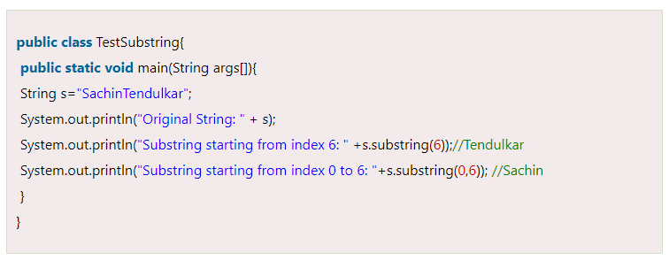
Substring in Java
Notes:
startIndex: inclusive
endIndex: exclusive

Slide 22
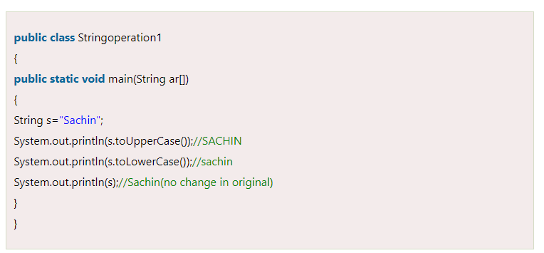
Uppercase & Downcase
Notes:
startIndex: inclusive
endIndex: exclusive

Slide 23
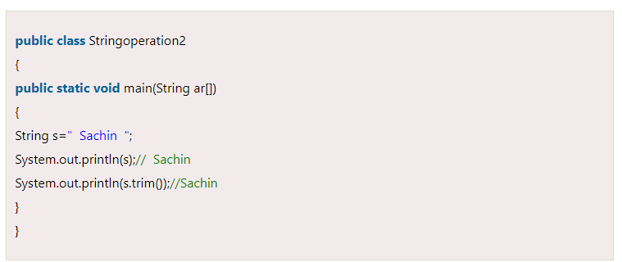
Java String trim() method
Notes:
The String class trim() method eliminates white spaces before and after the String.

Slide 24
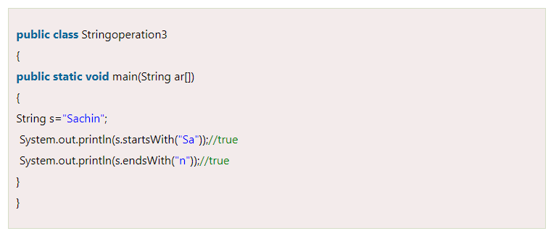
Java String startsWith() and endsWith()
Notes:
The method startsWith() checks whether the String starts with the letters passed as arguments and endsWith() method checks whether the String ends with the letters passed as arguments.

Slide 25
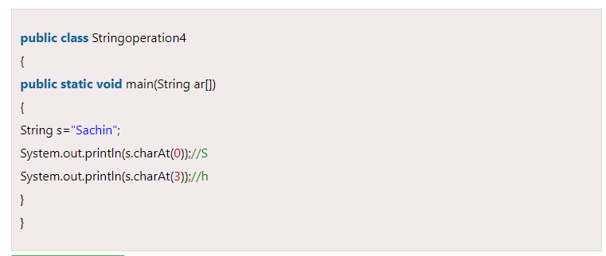
Java String charAt()
Notes:
The String class charAt() method returns a character at specified index.

Slide 26
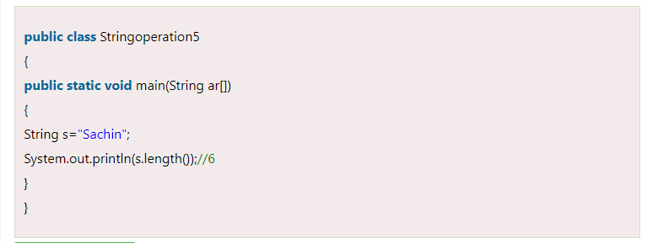
Java String length()
Notes:
The String class length() method returns length of the specified String.

Slide 27
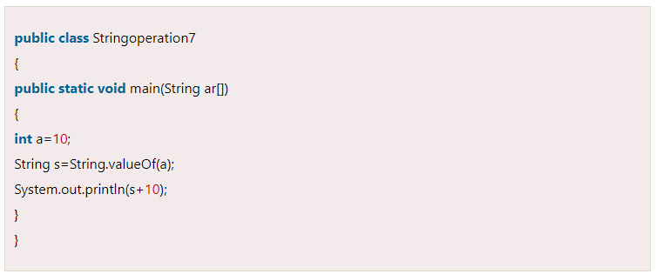
Java String valueOf()
Notes:
The String class valueOf() method coverts given type such as int, long, float, double, boolean, char and char array into String.

Slide 28
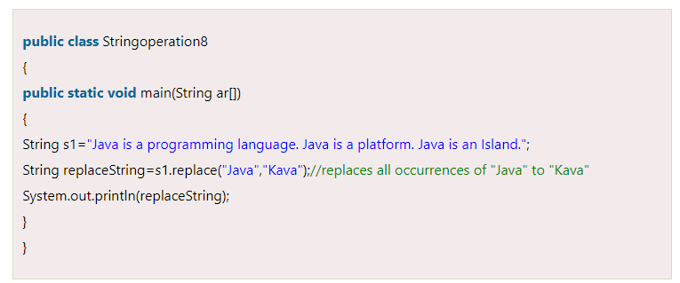
Java String replace()
Notes:
The String class replace() method replaces all occurrence of first sequence of character with second sequence of character.

Slide 29
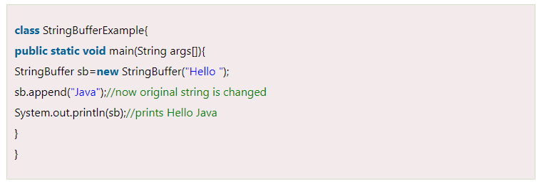
Java StringBuffer Class 1) StringBuffer Class append()
Notes:
Java StringBuffer class is used to create mutable (modifiable) String objects. The StringBuffer class in Java is the same as String class except it is mutable i.e. it can be changed.

Slide 30
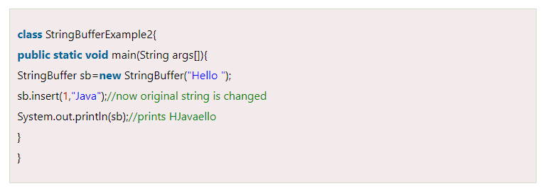
2) StringBuffer insert()
Notes:
The insert() method inserts the given String with this string at the given position.

Slide 31
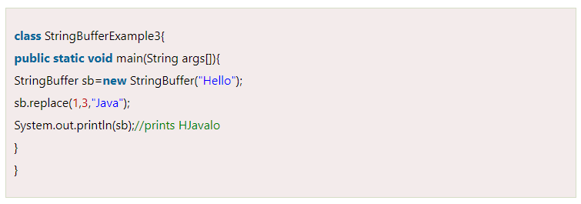
3) StringBuffer replace() Method
Notes:
The replace() method replaces the given String from the specified beginIndex and endIndex.

Slide 32
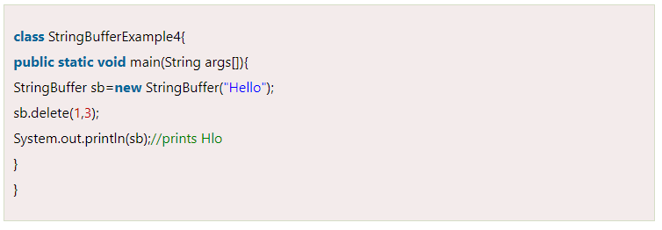
4) StringBuffer delete() Method
Notes:
The delete() method of the StringBuffer class deletes the String from the specified beginIndex to endIndex.

Slide 33
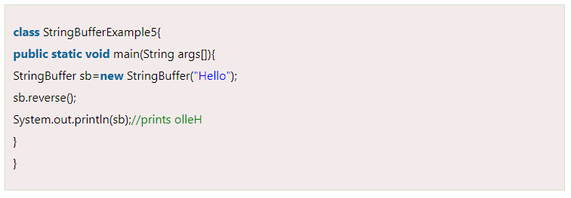
5) StringBuffer reverse() Method
Notes:
The reverse() method of the StringBuilder class reverses the current String.

Slide 34
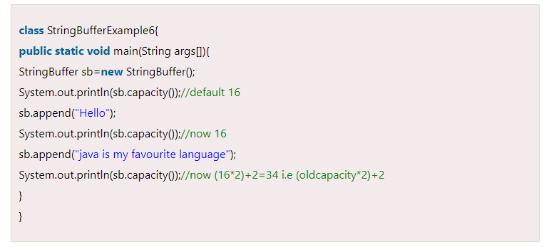
6) StringBuffer capacity() Method
Notes:
The capacity() method of the StringBuffer class returns the current capacity of the buffer. The default capacity of the buffer is 16. If the number of character increases from its current capacity, it increases the capacity by (oldcapacity*2)+2. For example if your current capacity is 16, it will be (16*2)+2=34.

Slide 35
—Anonymous
"In Java, a string is more than just a sequence of characters; it's an object with powerful manipulation methods."

Slide 36
Thanks!
Do you have any questions?
amerosama.jr@gmail.com
01007698027

